Slide 1
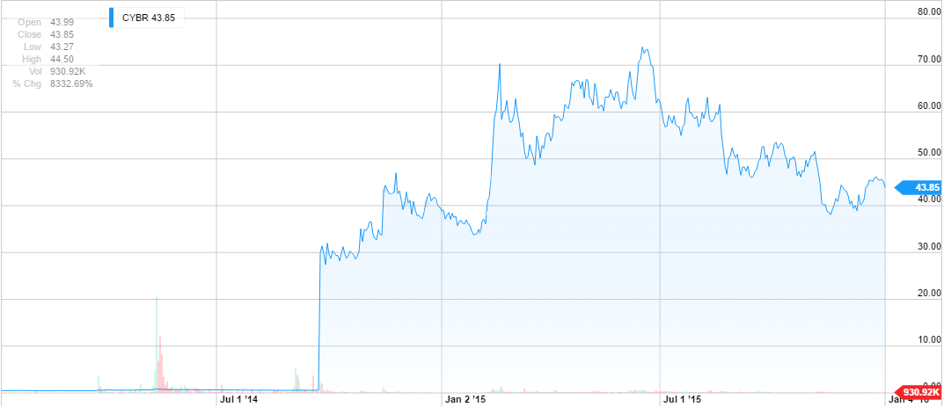
CyberArk Inc. (CYBR)
Arman Hastings
1/8/2016
Technology Sector

Slide 2



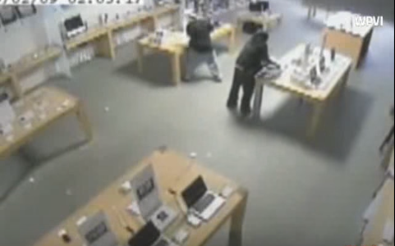

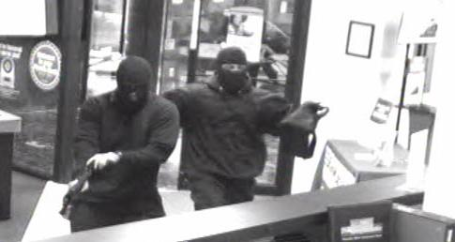
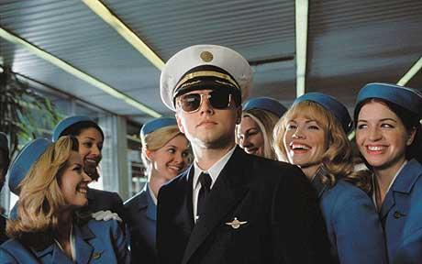
What Can be Hacked?
Areas where a company or entity is Venerable for Attack
Physical
Cyber
Social

Slide 3
Business Overview
Their business model doesn’t depend on hacking happening to be useful.
Customer Experience is the same whether they are Amazon or a small bank
Proactive security
Focused on working from the inside out.
Because it is focused on protecting the users on the inside their products act as an extra layer, complementing the products at other popular Cyber security companies such as, Palo Alto, FireEye and Cisco
Focused on improving the security of privileged accounts within company
Privileged accounts have administrative controls built into every piece of the IT infrastructure.
In the hands of an attacker they have full control over everything
This is exactly what happened when Sony was hacked

Slide 4
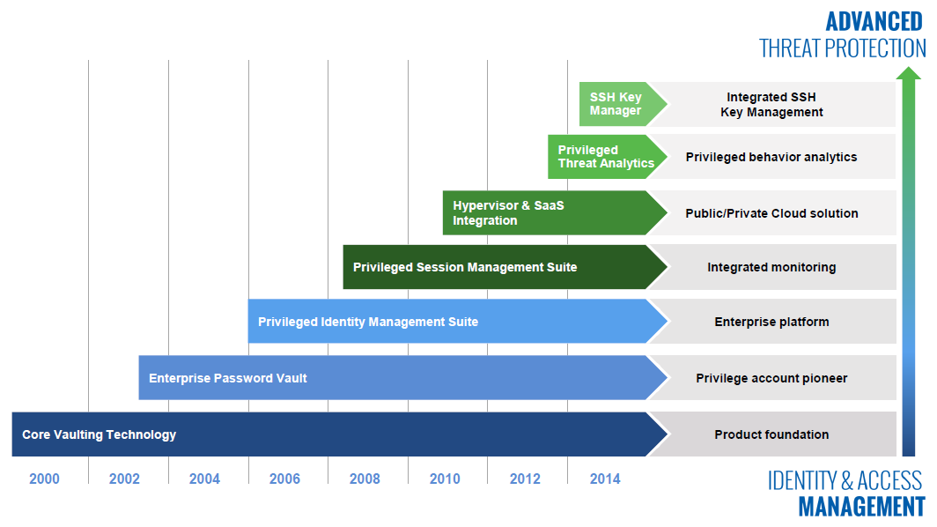
Competitive Positioning

Slide 5
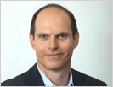
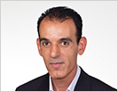

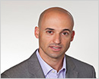


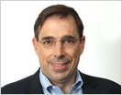
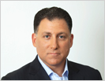
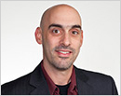

Corporate Governance
Full Management Team
Udi Mokady Founder, President & CEO
Chen Bitan General Manager, EMEA & APAC
Josh Siegel Chief Financial Officer
Ron Zoran Vice President Sales, Americas
Nick Baglin Vice President Sales, EMEA
Roy Adar Senior Vice President, Product Management
John Worrall Chief Marketing Officer
Adam Bosnian EVP, Global Business Development
Nir Gertner Chief Information Technology Officer
Ruth Shaked Vice President, Human Resources

Slide 6







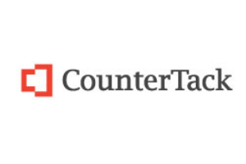


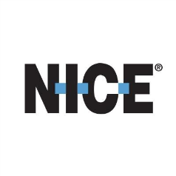


Corporate Governance
Udi Mokady Founder, President & CEO
Chen Bitan General Manager, EMEA & APAC
Josh Siegel Chief Financial Officer
John Worrall Chief Marketing Officer
Ron Zoran Vice President Sales, Americas
Roy Adar Senior Vice President, Product Management
Nick Baglin Vice President Sales, EMEA

Slide 7
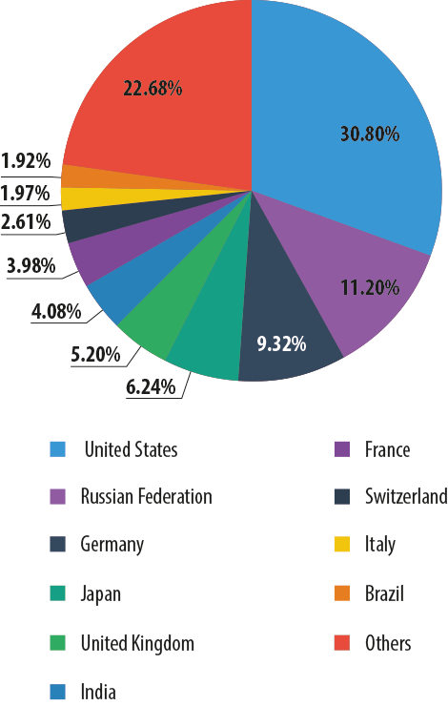
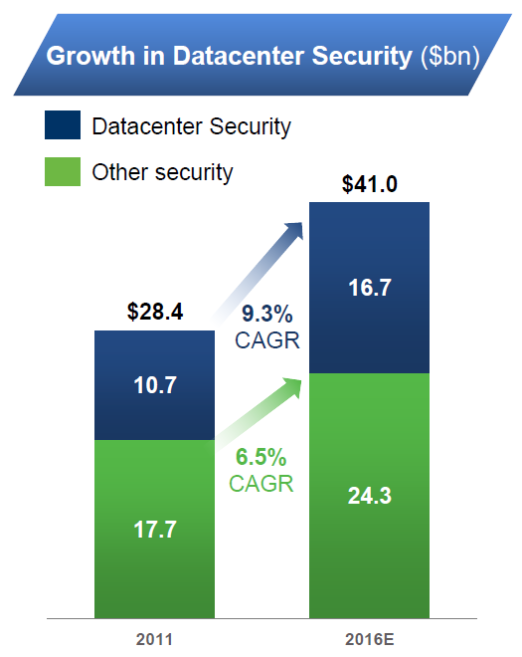
Catalyst #1
Increasing Importance of Cyber Security
America is the most targeted country for Cyber attacks. Being the catalyst for needed growth in the cyber security field.
Therefore company’s funds allocation and cyber
Security spending is going up in general

Slide 8

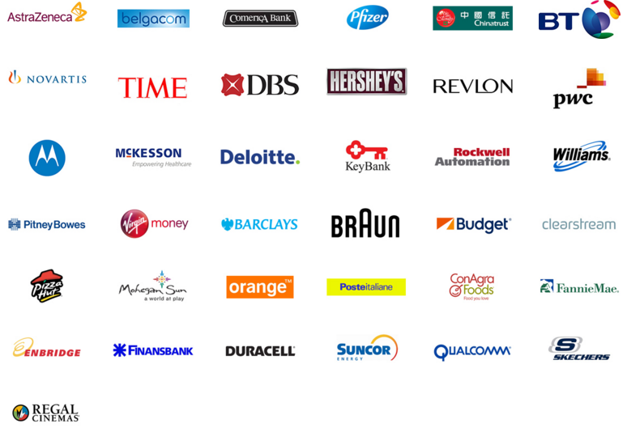


Catalyst #2
Growth and Customer Base
2,000+ Global Customers
40% of Fortune 100
20% of Global 2000

Slide 9
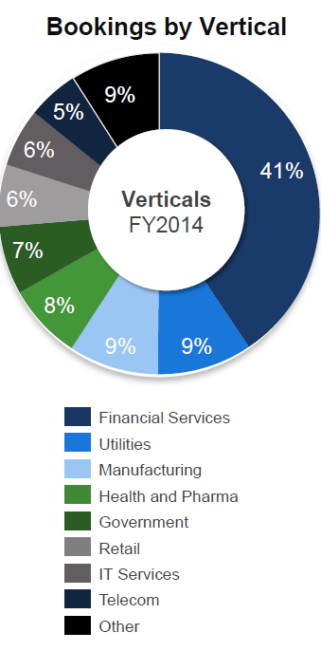
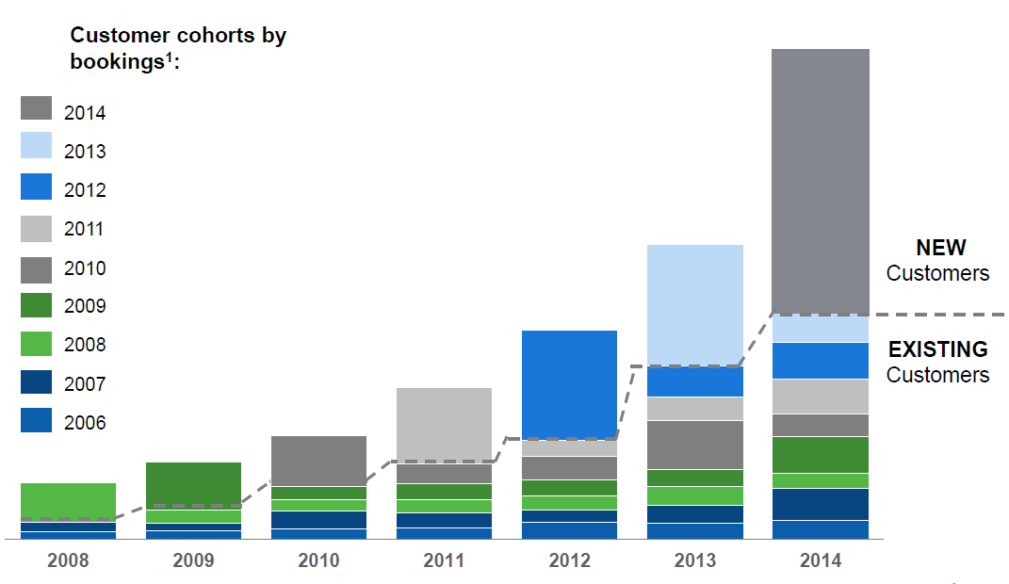
Catalyst #2
Growth and Customer Base
Bookings include maintenance and new customers
Diversified into may sectors as any company can be attacked

Slide 10
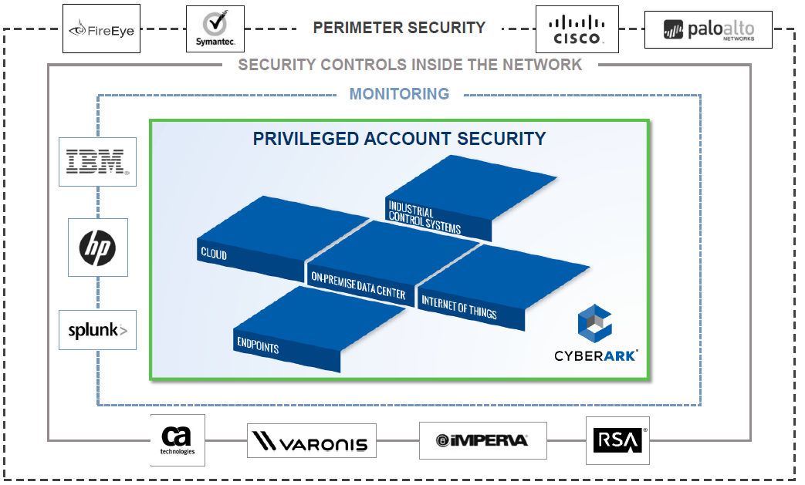
Catalyst #3
Business Model

Slide 11
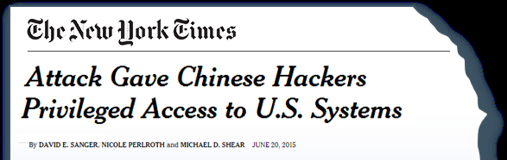
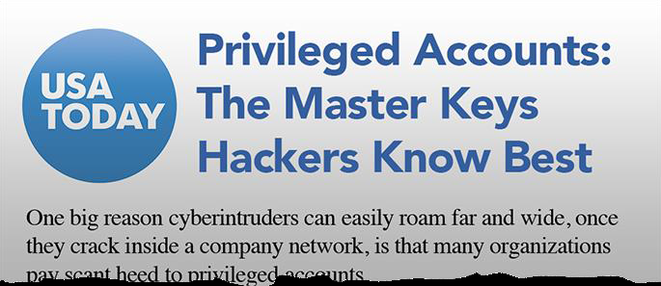
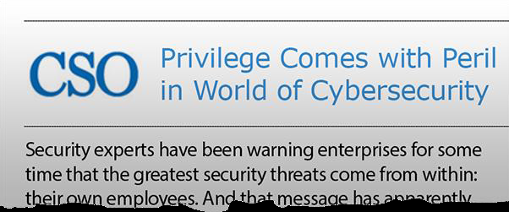
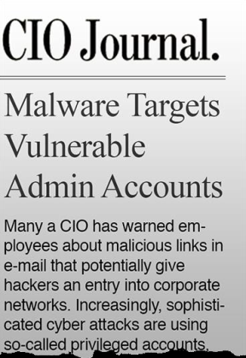
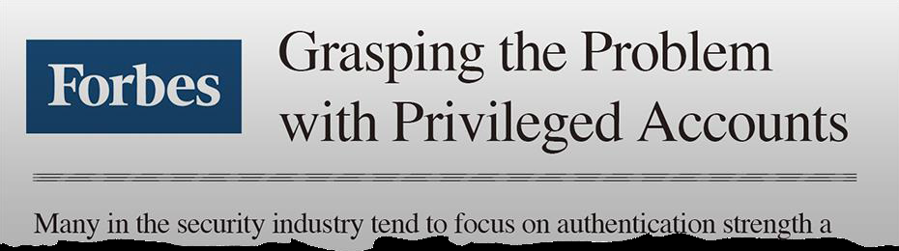
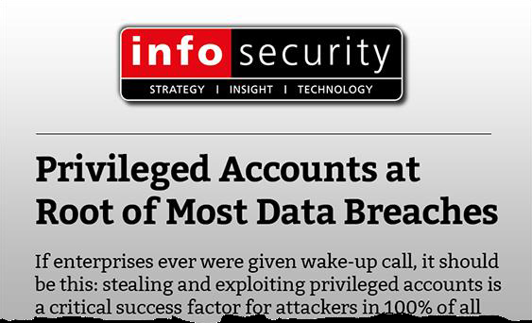
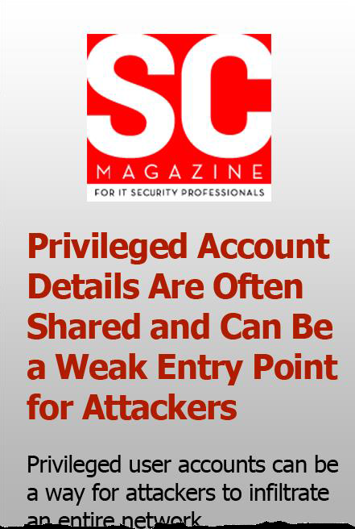
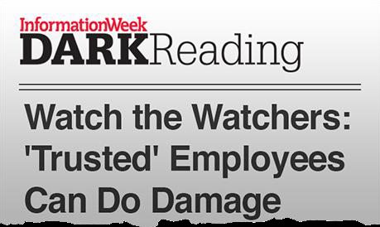
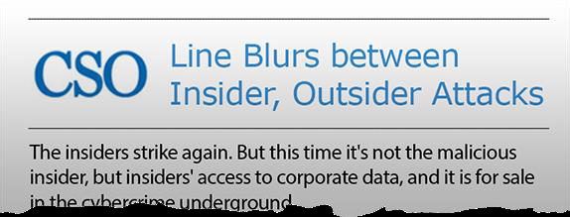
Catalyst #3
Business Model

Slide 12
Current Events
12/22/15: Report: CyberArk Named the Privilege Management Leader by KuppingerCole
12/16/15: CyberArk Wins 2015 Government Security News Homeland Security Awards
12/9/15: CyberArk Survey Finds Executives Overly Reliant on Compliance Metrics to Measure Security Program Effectiveness
12/7/15: CyberArk to Discuss Extending Privileged Account Security to the Endpoint at Gartner Identity & Access Management Summit

Slide 13
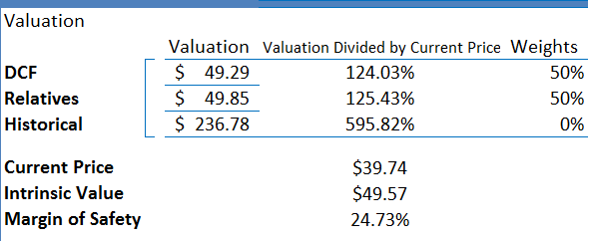
Valuation

Slide 14
Recommendation
BUY
I do understand the historical financial data and the general access of CYBR’s financial data is limited, and that CyberArk is still a very young company.
However I do still recommend a Buy because of the necessity of Cyber security, and the fact that they have established a fantastic reputation not only from their methods but their customers.

Slide 15
Questions?

